Slide 1
Dow jones stock analysis
Group 1

Slide 2
AGENDA
Introduction
Primary goals
Summary

Slide 3
tasks
1. Merge and clean Data
2. Create data frame with open, high, close, adj, and low.
3. Analyze the Stocks that went up and down in the past few years with the lowest and highest values
4. Five best and worst stocks invested in the past two years
5. Do stocks stats, mean, median, and standard deviation.
6. Create 5-line charts.
7. what stock has are better to invest?
8. Betha Analysis
9. Correlation Matrix with all the stocks
10. Written analysis comparing S&p500 with Dow Jones results.
11. Add Summary

Slide 4
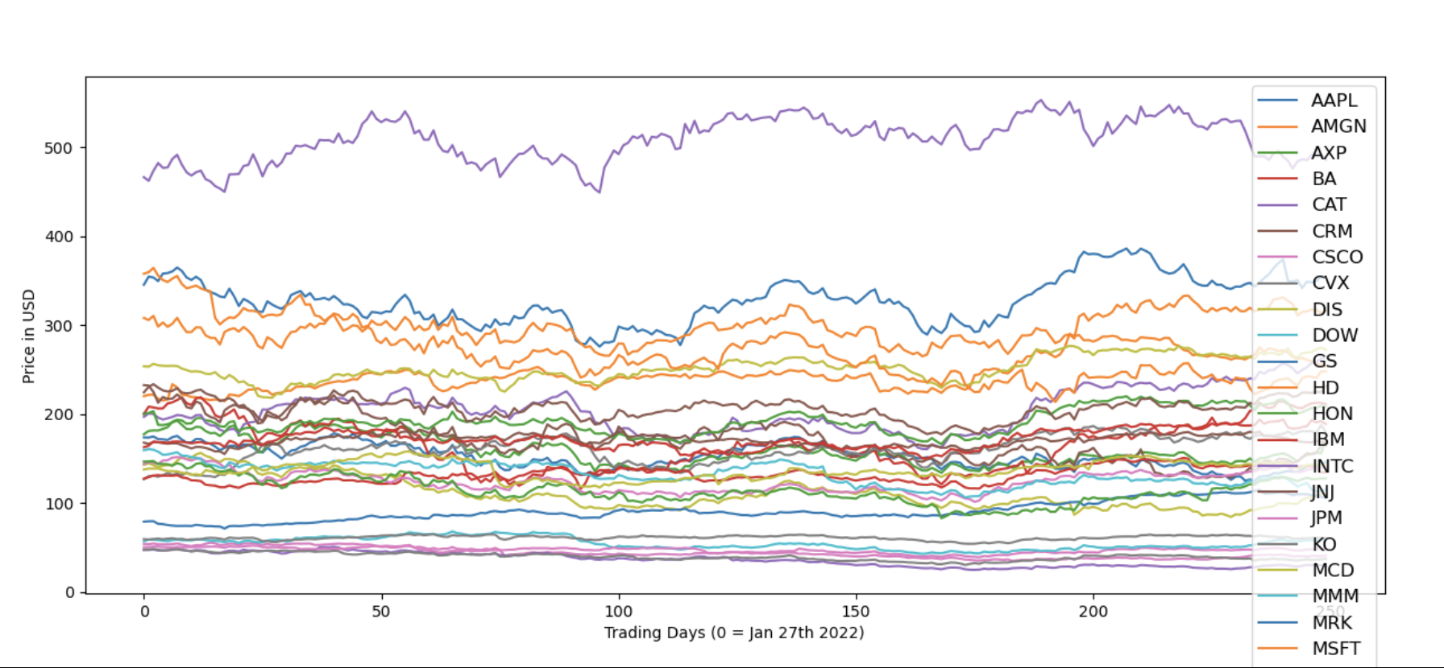
Dow Jones stock pricing 1-year

Slide 5
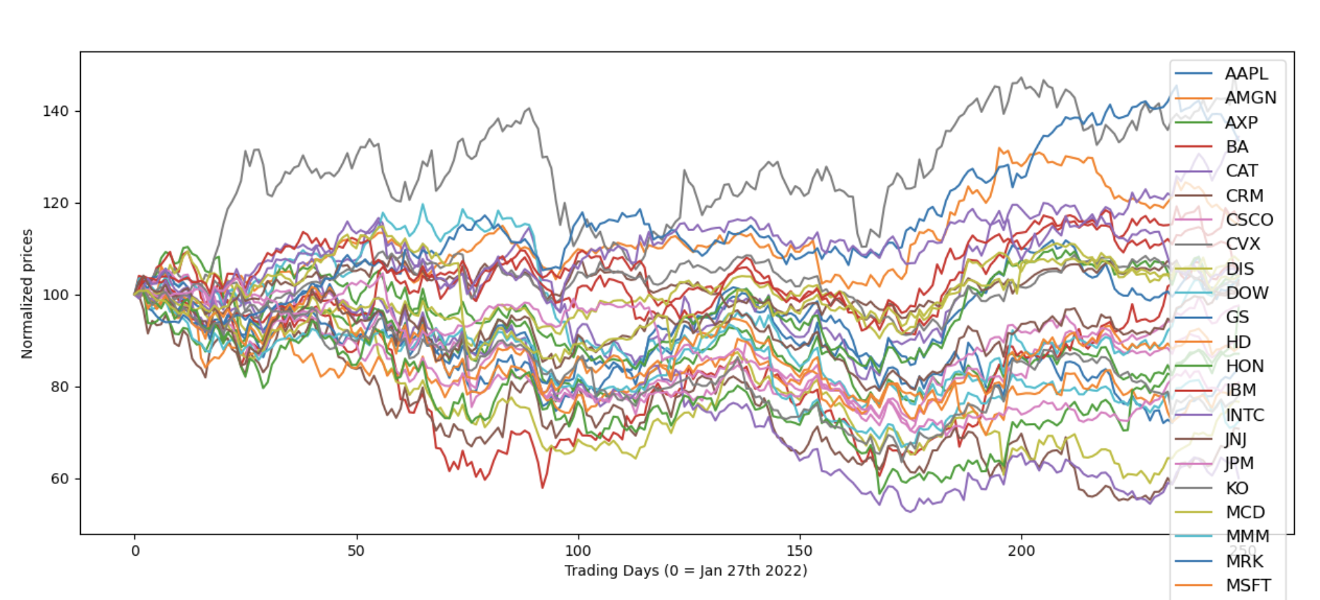
Dow Jones stock pricing - normalized

Slide 6
Statistical analysis of stocks in dow jones
Highest mean | Lowest mean | Highest Median | Lowest Median | Highest var | Lowest Var | Highest std | Lowest std | Highest Sem | Lowest Sem
0 | CVX | CRM | CVX | CRM | INTC | JNJ | INTC | JNJ | INTC | JNJ
1 | MRK | INTC | MRK | DIS | MRK | KO | MRK | KO | MRK | KO
2 | AMGN | DIS | AMGN | INTC | BA | UNH | BA | UNH | BA | UNH
3 | UNH | NKE | UNH | NKE | DIS | V | DIS | V | DIS | V
4 | TRV | BA | TRV | MMM | CAT | MCD | CAT | MCD | CAT | MCD

Slide 7
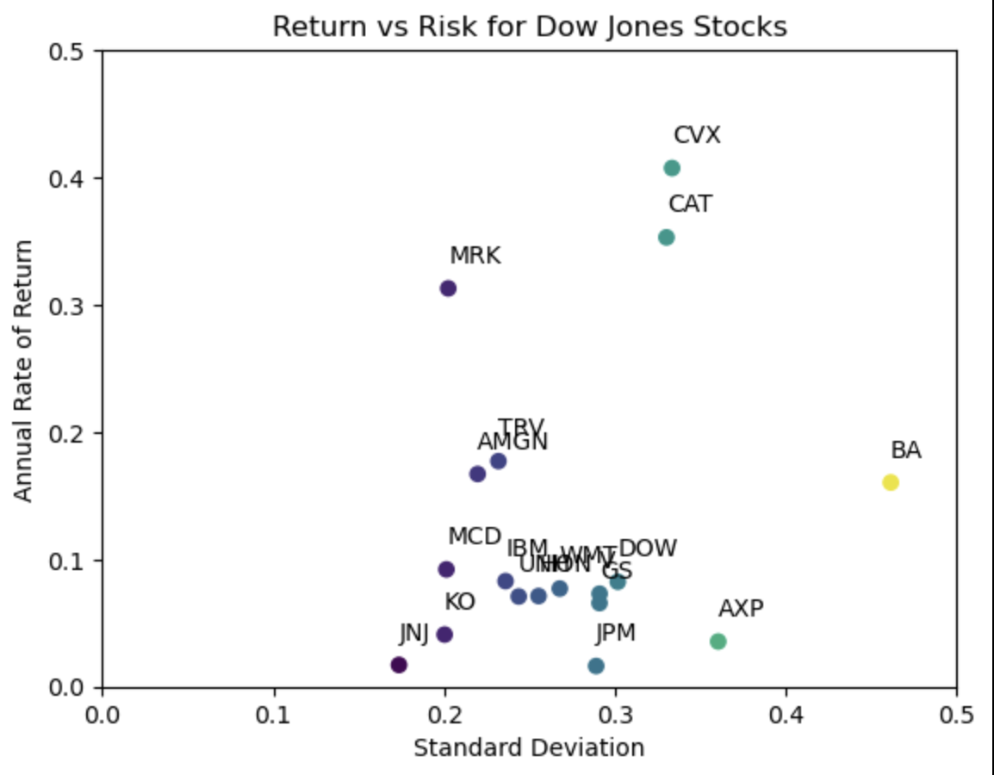

Slide 8
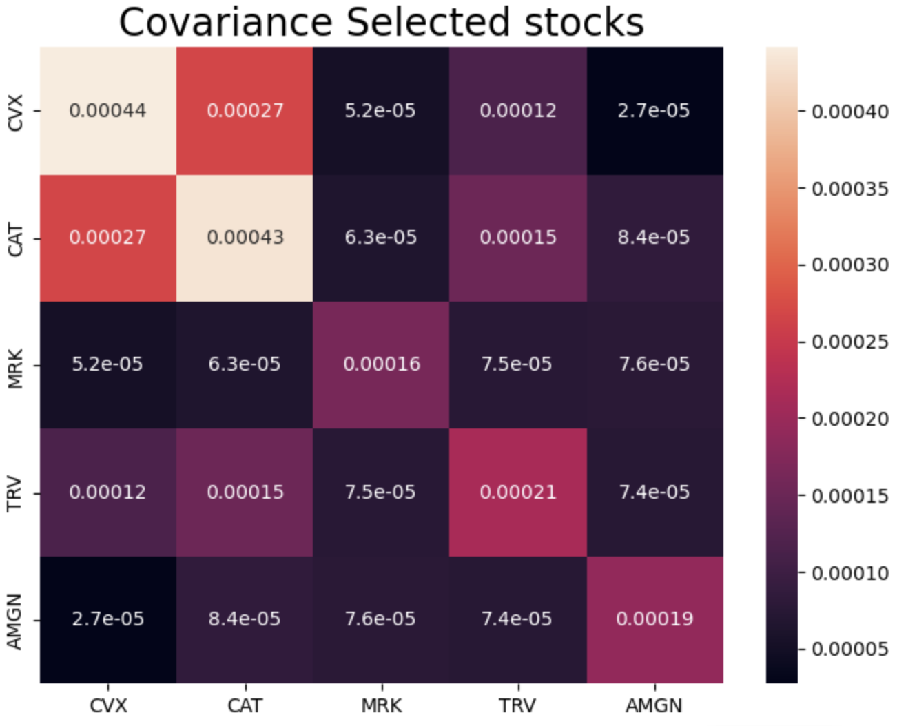
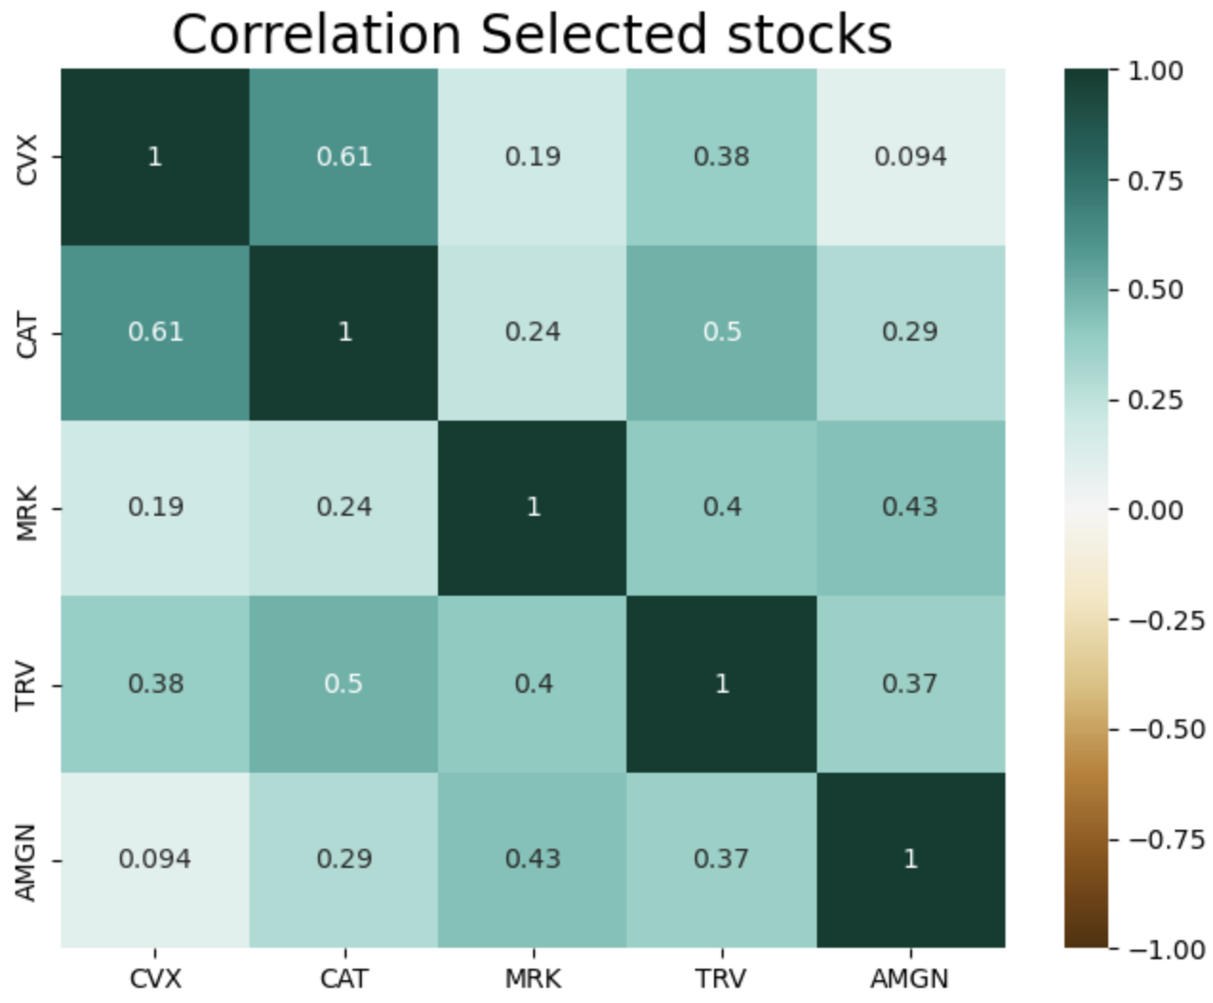

Slide 9
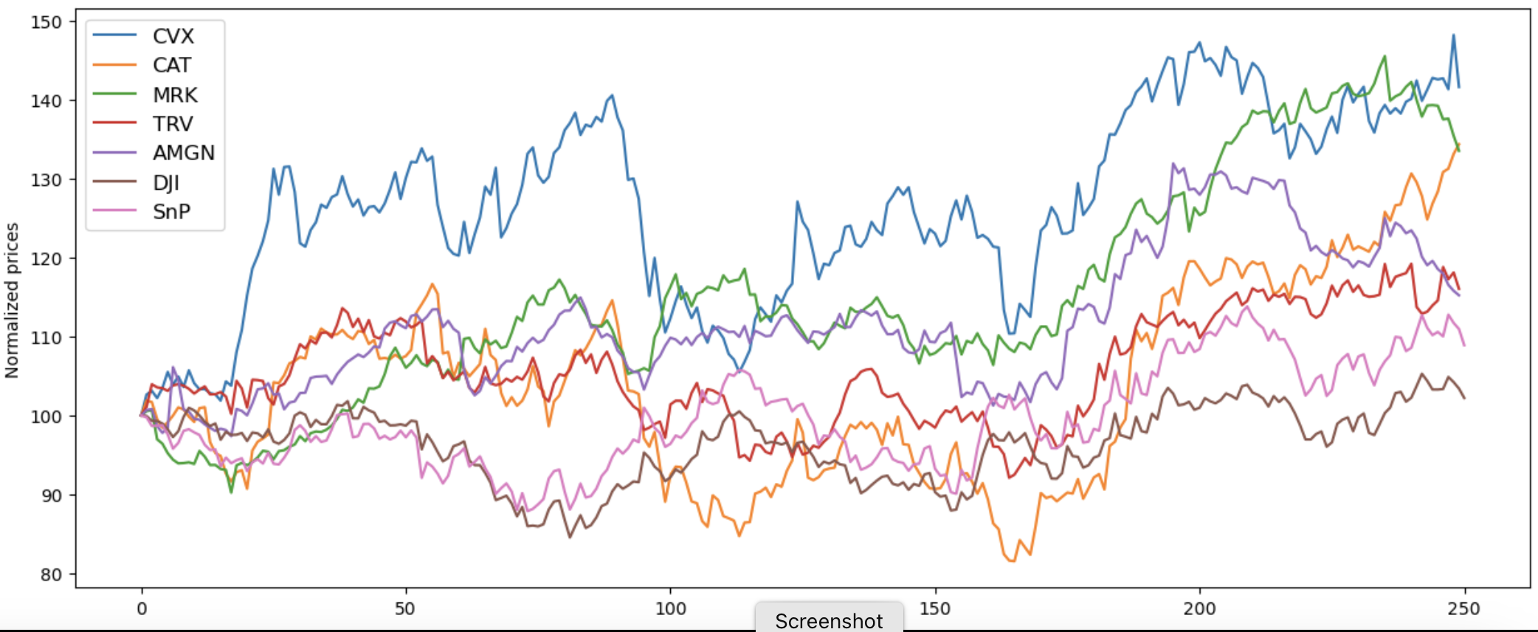
Selected stock to be used for efficient portfolio

Slide 10
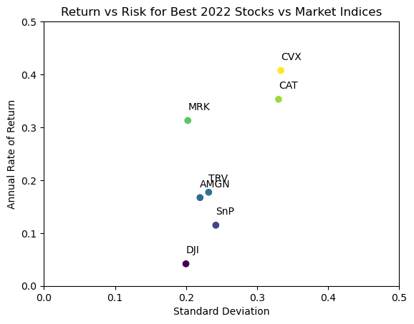

Slide 11
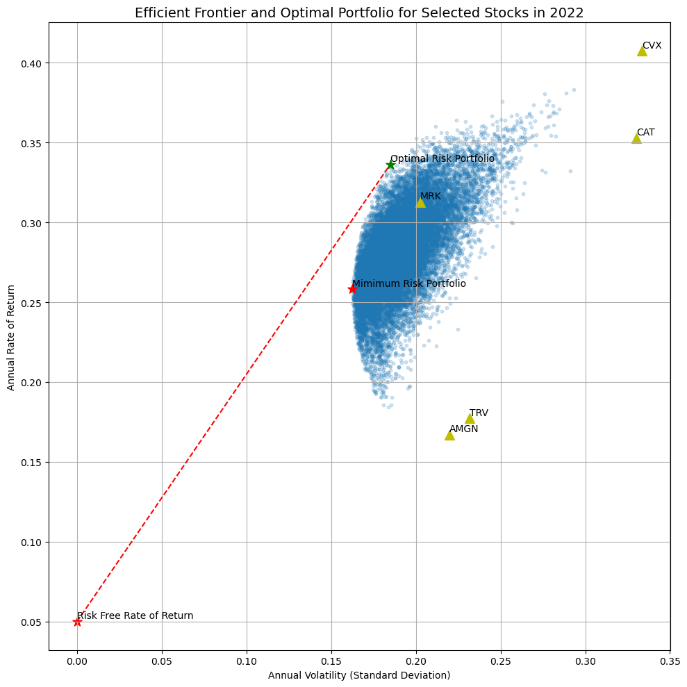
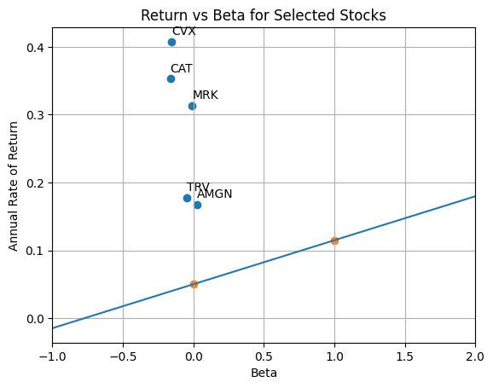

Slide 12
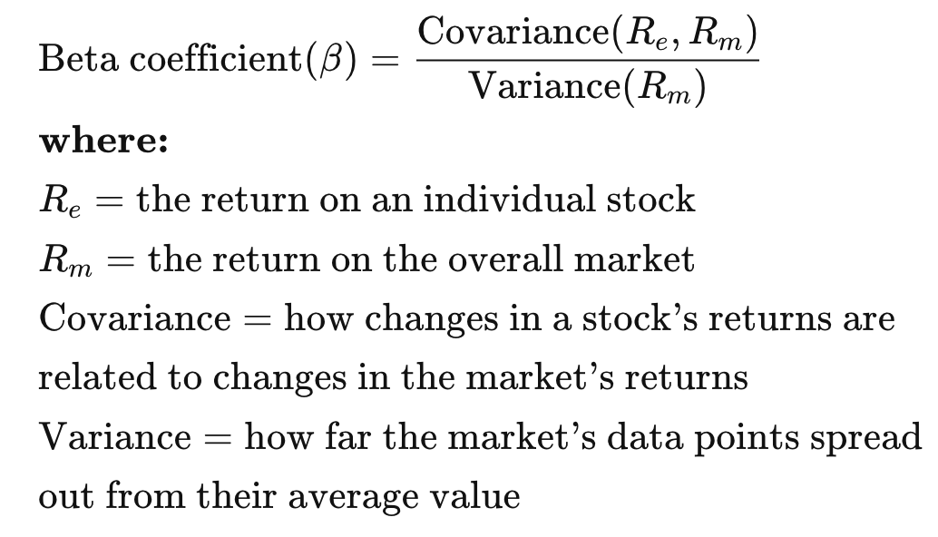
Stock’s Alpha
S&P 500
Risk Free Asset = 0.05 return

Slide 13
THANK YOU

